Slide 1

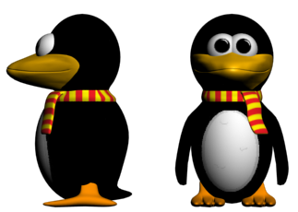
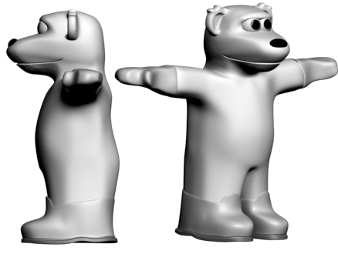
Design: Character Development
Penguin
Has two different animations
Has water submersion frames
Rendered and in game
Polar bear
Has two different animations
Needs water submersion frames
Rendered and ready for insertion into ..later levels

Slide 2
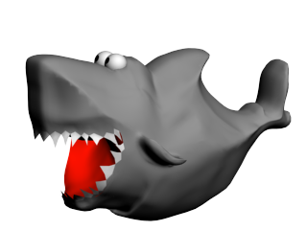
Design: Character Development
Artic Shark
Now has two different animations
Render problem solved
Rendered and in game

Slide 3
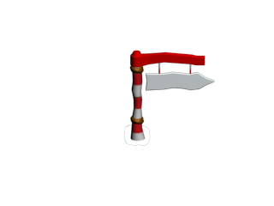
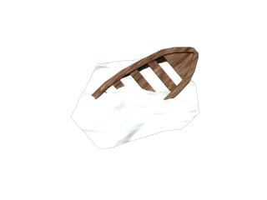
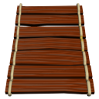

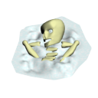
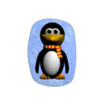
Design: Additional Game Assets
Signpost – Directing the player
Bridge – Finnish the level
Boat – Decoration
Life symbol – shows how
many lives the player has
Snowman – Checkpoint
Skeleton – Decoration may be used
in conjunction with the map asset

Slide 4
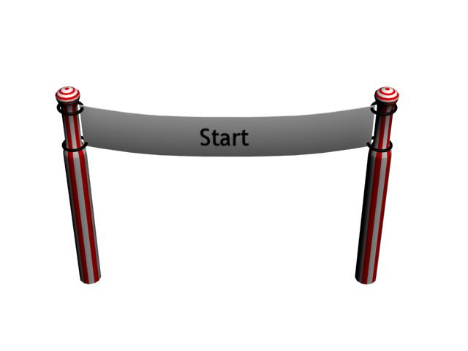
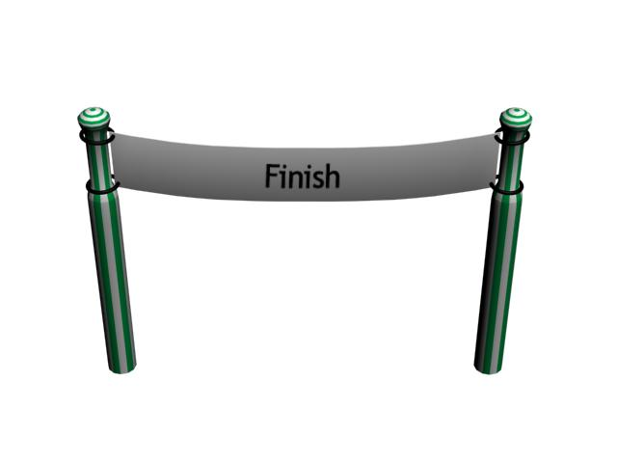
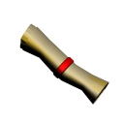
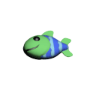
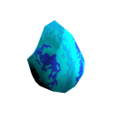
Design: Additional Game Assets
Start gate – Shows the player
spawn location
Finnish gate – Shows the Finnish
location of the level
Map – A collectible object that
allows the player to use the map
option
Fish – Collectible object
Bolder – Collision object
(polar bear can break it)

Slide 5
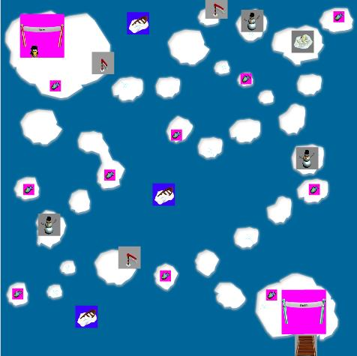
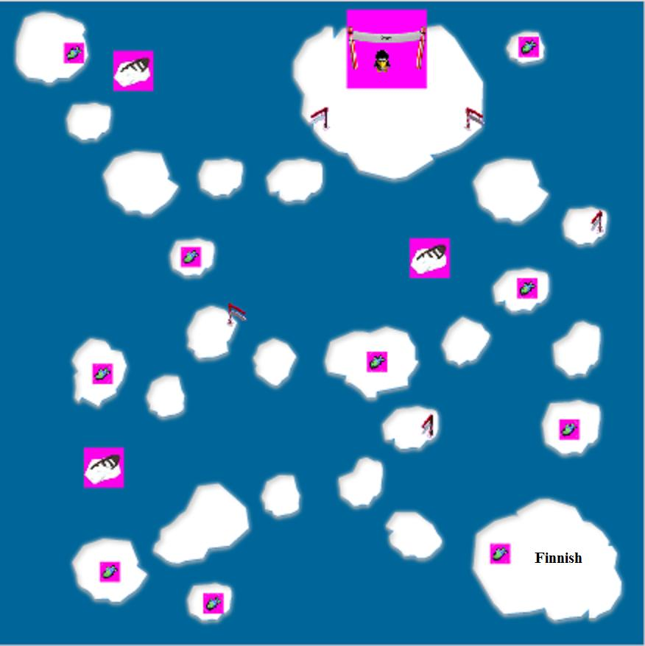
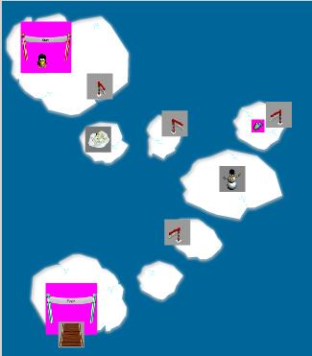
Design: Level
Tutorial level
Level one
Level Two

